Slide 1


Implementing standards-based fair health data re-use

Slide 2

Going from our WHY to the HOW and the WHAT
WHY
We decided to create value by aiming for a paradigm shift
Digital health and personal data are central to the paradigm
Our strategy is to focus on patient groups and care providers
HOW
Use “Health Data Commons” (working title) framework for standards-based implementation of demonstrators
WHAT
Specify components, partners and business model for each project within framework

Slide 3
HOW: “Health Data Commons” frameworks
COMMON
SERVICES
CR - Client Registry
FR - Facility Registry
HWR - Health Worker Registry
TS - Terminology Services
PC - Product Catalogue
BUSINESS
SERVICES
FIS - Finance & Insurance Service
HMIS - Health Mgt. Info. System
LMIS - Logistics Mgt. Info. Service
SHR - Shared Health Record
Based on OpenHIE
One of the most widely used architectural frameworks for implementing health data exchange
Standards-based, modular and with increasing number of implementations More info: OpenHIE documentation
Why is it relevant for us?
Many African countries have adopted it or use similar frameworks (Nigeria, Kenya, Tanzania, review HIE in Africa)
Digital technologies have matured in the past decade, creating opportunities for more effective and efficient implementation of openHIE components using open source components
INTEROPERABILITY LAYER (IOL)
AC - Admin Console
ATNA - Audit Trail & Node Authentication
ILS - Interlinking and Routing Services, also known as Channels in the reference implementation
MEDIATORS - Pass-through, Adapter or Orchestration mediators
POINT OF SERVICE (POS) SYSTEMS
Different types of PoS systems are allowed, including EMR/EHRs (Electronic Health / Medical Record systems), mobile apps for patient or community workers and information systems for hospitals, pharmacies and laboratories.
Key defining characteristics are the workflows that are supported by the system (see examples).

Slide 4
HOW: Following Kenya’s architecture, we add Analytics & Intelligence Services to our framework
COMMON
SERVICES
CR - Client Registry
FR - Facility Registry
HWR - Health Worker Registry
TS - Terminology Services
PC - Product Catalogue
BUSINESS
SERVICES
FIS - Finance & Insurance Service
HMIS - Health Mgt. Info. System
LMIS - Logistics Mgt. Info. Service
SHR - Shared Health Record
ANALYTICS & INTELLIGENCE SERVICES
Secondary re-sue of data
Insights from visit to Kenya
Little focus on implementing analytics & intelligence services, whilst there is a need by third-parties for secondary access and re-use
No consensus / clear definitions on type of re-use:
Primary data re-use: positioned within routine health delivery process, envisioned to be a market of supplier of business services
Secondary data re-use: positioned as re-use of data for analytical and intelligence purposes by academic institutions, pharma companies etc.
INTEROPERABILITY LAYER (IOL)
AC - Admin Console
ATNA - Audit Trail & Node Authentication
ILS - Interlinking and Routing Services, also known as Channels in the reference implementation
MEDIATORS - Pass-through, Adapter or Orchestration mediators
POINT OF SERVICE (POS) SYSTEMS
Different types of PoS systems are allowed, including EMR/EHRs (Electronic Health / Medical Record systems), mobile apps for patient or community workers and information systems for hospitals, pharmacies and laboratories.
Key defining characteristics are the workflows that are supported by the system (see examples).

Slide 5
HOW: Following Kenya’s architecture, we add Analytics & Intelligence Services to our framework
COMMON
SERVICES
CR - Client Registry
FR - Facility Registry
HWR - Health Worker Registry
TS - Terminology Services
PC - Product Catalogue
BUSINESS
SERVICES
FIS - Finance & Insurance Service
HMIS - Health Mgt. Info. System
LMIS - Logistics Mgt. Info. Service
SHR - Shared Health Record
ANALYTICS & INTELLIGENCE SERVICES
Secondary re-sue of data
Insights from visit to Kenya
Little focus on implementing analytics & intelligence services, whilst there is a need by third-parties for secondary access and re-use
No consensus / clear definitions on type of re-use:
Primary data re-use: positioned within routine health delivery process, envisioned to be a market of supplier of business services
Secondary data re-use: positioned as re-use of data for analytical and intelligence purposes by academic institutions, pharma companies etc.
INTEROPERABILITY LAYER (IOL)
AC - Admin Console
ATNA - Audit Trail & Node Authentication
ILS - Interlinking and Routing Services, also known as Channels in the reference implementation
MEDIATORS - Pass-through, Adapter or Orchestration mediators
POINT OF SERVICE (POS) SYSTEMS
Different types of PoS systems are allowed, including EMR/EHRs (Electronic Health / Medical Record systems), mobile apps for patient or community workers and information systems for hospitals, pharmacies and laboratories.
Key defining characteristics are the workflows that are supported by the system (see examples).

Slide 6

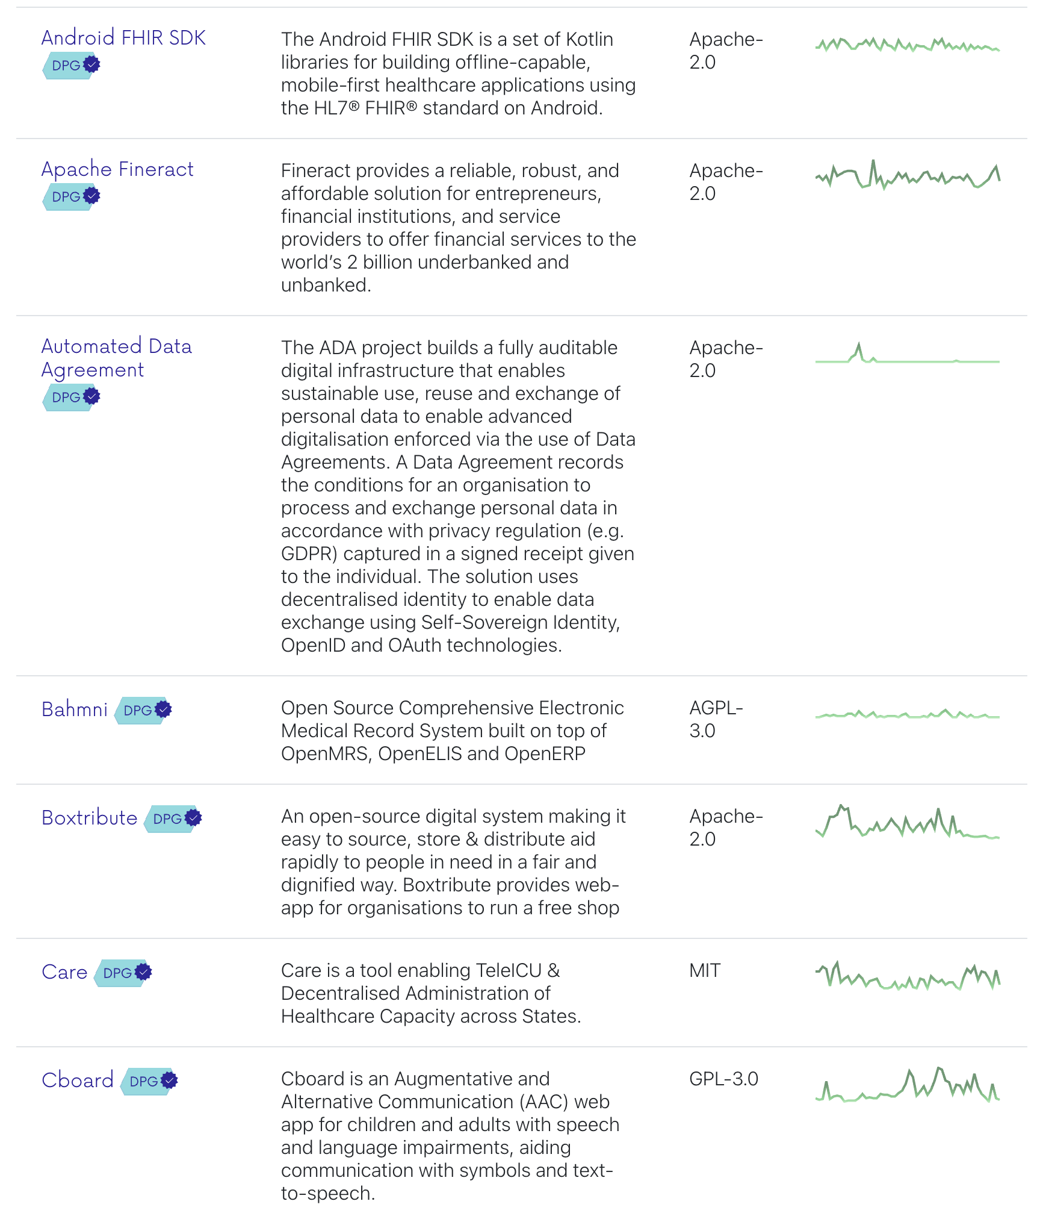
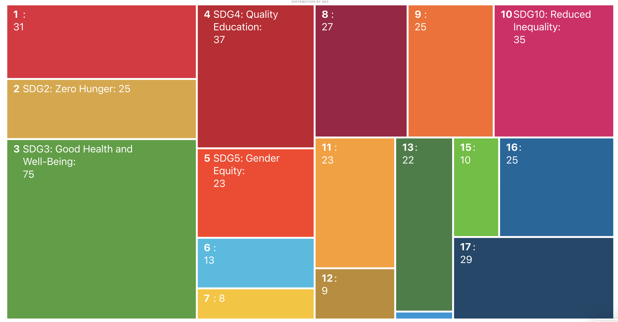
HOW: contribute to Digital Public Goods
152 open source software components of which 75 in health domain

Slide 7

HOW: Beyond technology, we want demonstrate sustainable fair data sharing
Three pillars towards fair data sharing
1. Facilitating data use that creates significant public value
2.
Preventing and mitigating harm
3. Revenue sharing / “taxing” data use by third parties that generate little or no public value
Source: Barbara Prainsack et al., Data Solidarity (2022)

Slide 8
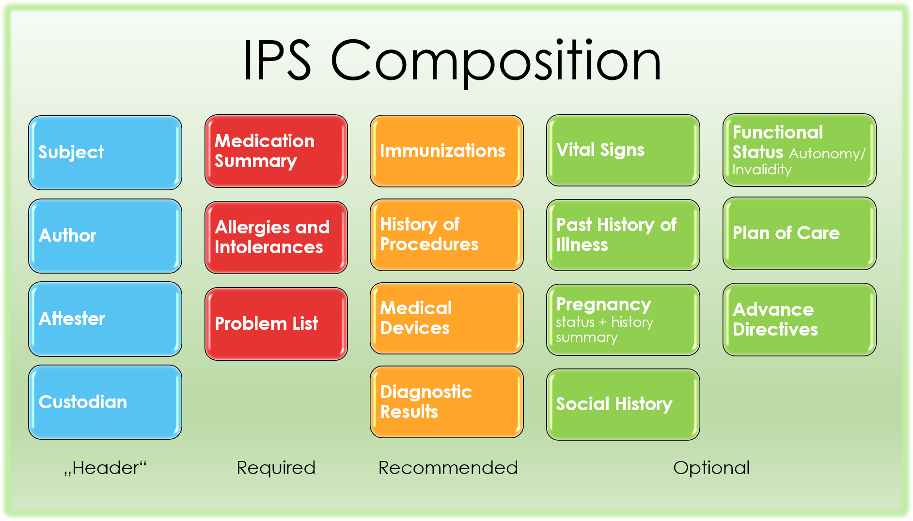
WHAT: International Patient Summary (IPS) as starting point for SHR
Details: FHIR IPS
Additions:
Questionnaire
QuestionnaireResponse
ServiceRequest (for referral)

Slide 9






WHAT: Results technical demonstrators with MomCare Tanzania
PoS: Chain of Trust app functions as electronic medical record for MomCare programme
Interoperability: Demonstrator for FHIR translation to create ‘data station’ of shared health record for re-use
Business Services:
Automation of DHIS2 reporting based on shared health records
Implementation of Value Points Dashboard based on shared health records
Capability for plug-&-play publishing of dashboards into existing mobile web that is resilient to intermittent Internet connections
Analytics Services:
Configured analytics workbench (in-the-clear)
Pilot multi-party computation (MPC, in-the-blind)
COMMON
SERVICES
CR - Client Registry
FR - Facility Registry
HWR - Health Worker Registry
TS - Terminology Services
PC - Product Catalogue
BUSINESS
SERVICES
FIS - Finance & Insurance Service
HMIS - Health Mgt. Info. System
LMIS - Logistics Mgt. Info. Service
SHR - Shared Health Record
DS - Data Services (?!)
ANALYTICS & INTELLIGENCE SERVICES
Secondary re-sue of data
DHIS2 report
Shared Health Record
Value Points Dashboard
Analytics workbench
INTEROPERABILITY LAYER (IOL)
AC - Admin Console
ATNA - Audit Trail & Node Authentication
ILS - Interlinking and Routing Services, also known as Channels in the reference implementation
MEDIATORS - Pass-through, Adapter or Orchestration mediators
FHIR legacy mediator
POINT OF SERVICE (POS) SYSTEMS
Different types of PoS systems are allowed, including EMR/EHRs (Electronic Health / Medical Record systems), mobile apps for patient or community workers and information systems for hospitals, pharmacies and laboratories.
Key defining characteristics are the workflows that are supported by the system (see examples).
Chain of Trust app

Slide 10
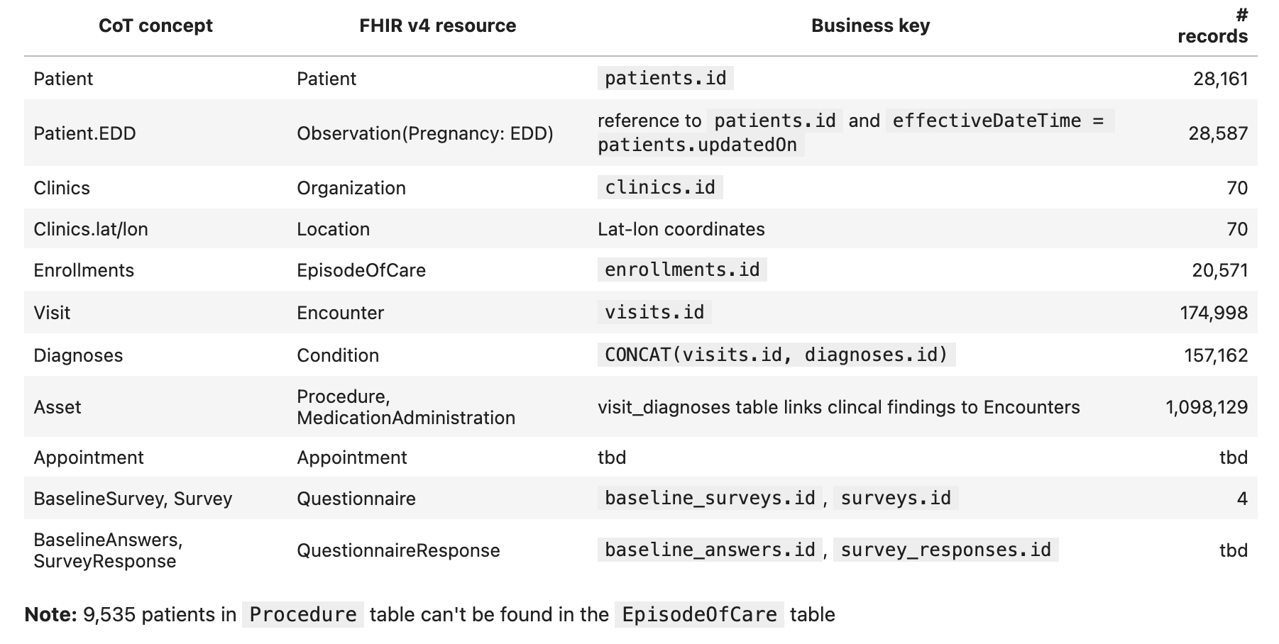
Results: FHIR transformed data Momcare Tanzania

Slide 11
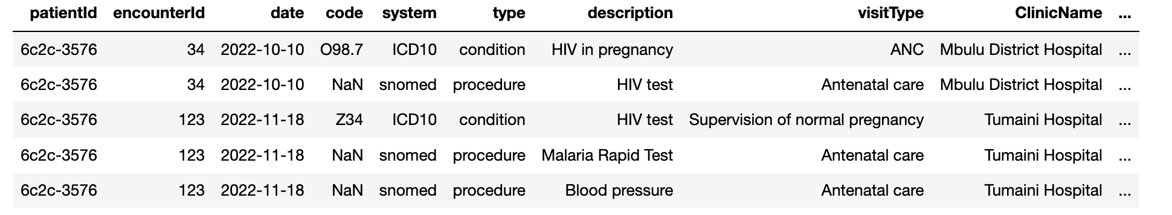
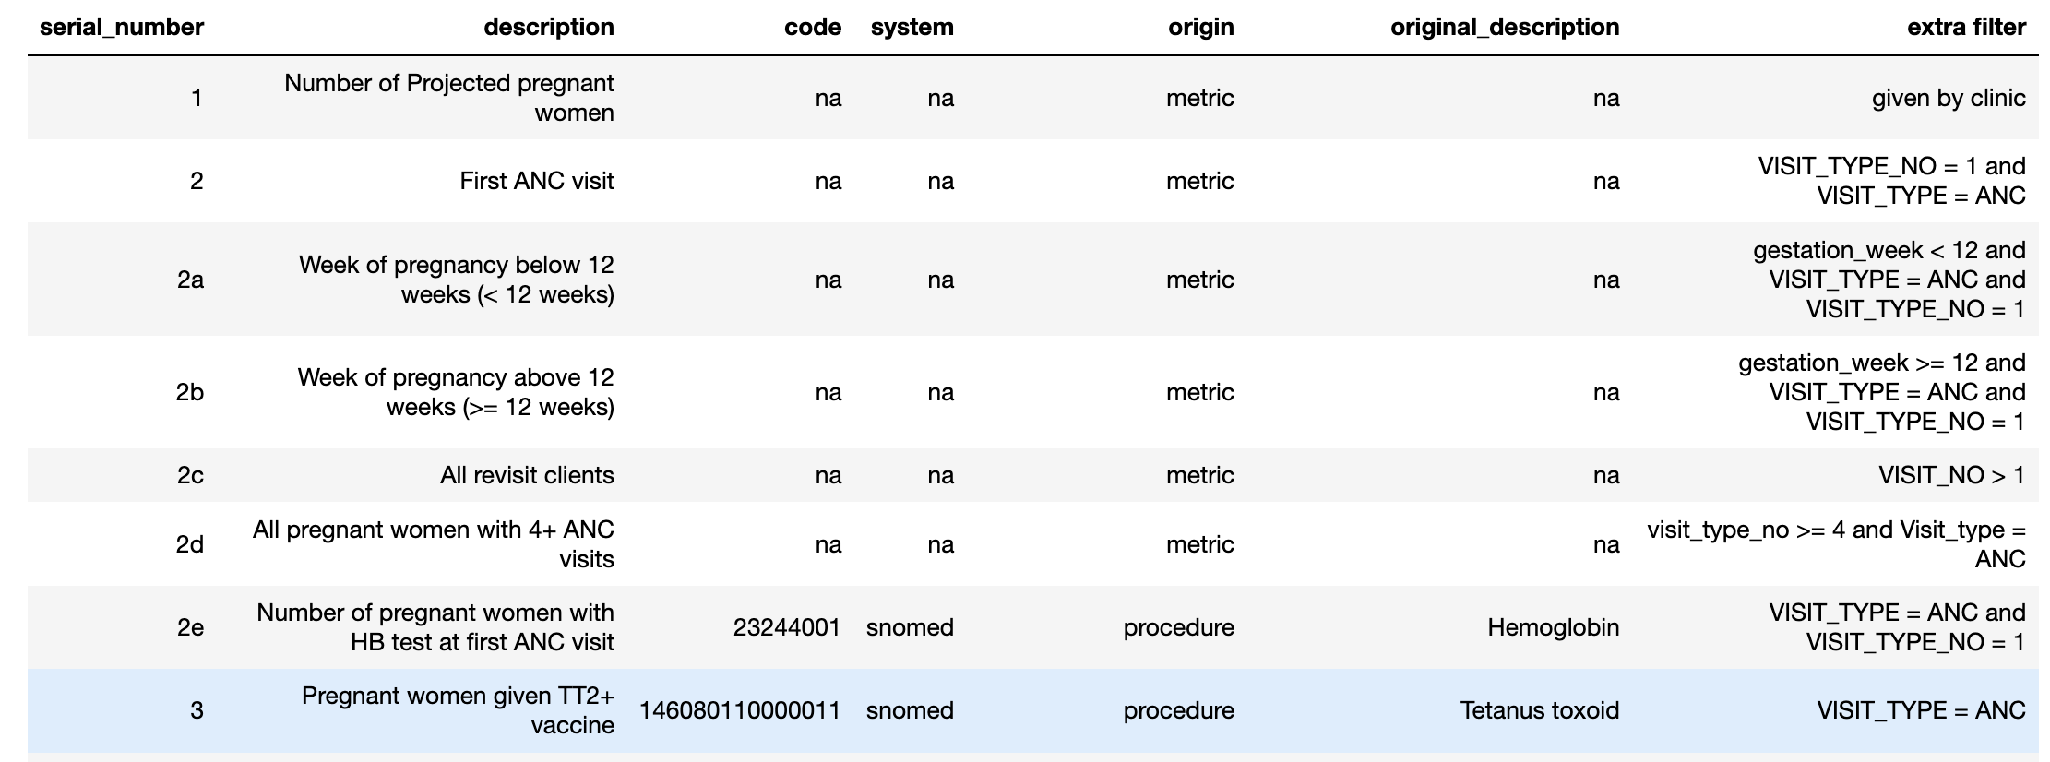
Results: patient-timeline table as basis for reporting
Patient-timeline as basis for business logic

Slide 12
Results: demo Value-Points Dashboard
https://cot-patient-journey-staging.web.app/home

Slide 13
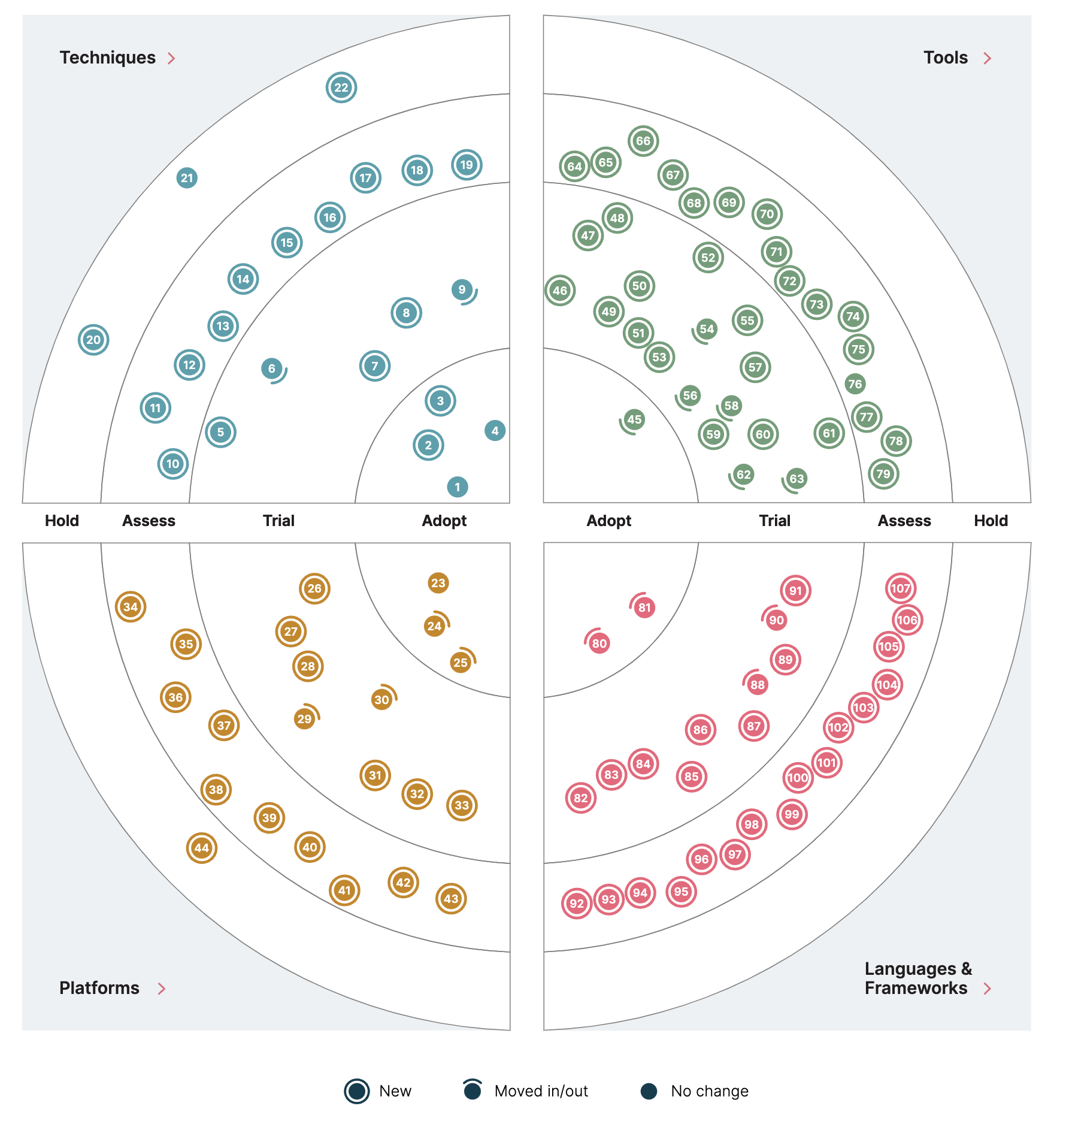
Results: underlying technology
Secure multi-party computation (MPC) solves the problem of collaborative computing that protects privacy between parties that do not trust each other. It's aim is to safely calculate an agreed-upon problem without a trusted third party, while each participant is required to partake in the calculation result and can't be obtained by other entities.
Analytics-on-FHIR use Bulk FHIR API as basis for analytics of patient populations.
Svelte web application framework that is optimized for low-resource settings and performance, including offline access.
Quarto an open-source scientific and technical publishing system. With it, we can build computational notebooks that allow you to write documents in markdown, embed code and emit that code’s output into the final document.
Duckdb embedded, lightweight database for use in web applications and analytics workbench.
Image: Technology Radar

Slide 14
WHAT: Our common task is to detail the components, partners and business model for each of our programmes
2. Specify which business domain services are required to run the programme, and the partners that will take up this role
COMMON
SERVICES
CR - Client Registry
FR - Facility Registry
HWR - Health Worker Registry
TS - Terminology Services
PC - Product Catalogue
BUSINESS
SERVICES
FIS - Finance & Insurance Service
HMIS - Health Mgt. Info. System
LMIS - Logistics Mgt. Info. Service
SHR - Shared Health Record
DS - Data Services (?!)
ANALYTICS & INTELLIGENCE SERVICES
Secondary re-sue of data
3. Identify third-parties through which the project can create revenues to sustain the ecosystem.
INTEROPERABILITY LAYER (IOL)
AC - Admin Console
ATNA - Audit Trail & Node Authentication
ILS - Interlinking and Routing Services, also known as Channels in the reference implementation
MEDIATORS - Pass-through, Adapter or Orchestration mediators
4. General guidelines in scoping a programme:
Speed over perfection
Use one of the existing FHIR-native Point-of-Record app if possible
Use FHIR data model (v4) by default
Always include Shared Health Record component, as this opens the door for more data re-use in future
1. Specify which Point-of-Service apps will be used by whom (e.g. CHIS by community worker)
POINT OF SERVICE (POS) SYSTEMS
Different types of PoS systems are allowed, including EMR/EHRs (Electronic Health / Medical Record systems), mobile apps for patient or community workers and information systems for hospitals, pharmacies and laboratories.
Key defining characteristics are the workflows that are supported by the system (see examples).

Slide 15
Discussion: proposal ‘Health Data Commons’
COMMON
SERVICES
CR - Client Registry
FR - Facility Registry
HWR - Health Worker Registry
TS - Terminology Services
PC - Product Catalogue
BUSINESS
SERVICES
FIS - Finance & Insurance Service
HMIS - Health Mgt. Info. System
LMIS - Logistics Mgt. Info. Service
SHR - Shared Health Record
ANALYTICS & INTELLIGENCE SERVICES
Secondary re-sue of data
Key elements proposal
Use-case: Chronic Care Models in Nairobi county
What we want to prove:
Implement working demonstrator, while MoH continues to formalize legislation
Non/pre-competitive space of data commons
Partners:
Faith-based facilities
IntelliSOFT for implementation of various components
Kenyan university as trusted party for managing Shared Health Record and Analytics Services
…
INTEROPERABILITY LAYER (IOL)
AC - Admin Console
ATNA - Audit Trail & Node Authentication
ILS - Interlinking and Routing Services, also known as Channels in the reference implementation
MEDIATORS - Pass-through, Adapter or Orchestration mediators
POINT OF SERVICE (POS) SYSTEMS
Different types of PoS systems are allowed, including EMR/EHRs (Electronic Health / Medical Record systems), mobile apps for patient or community workers and information systems for hospitals, pharmacies and laboratories.
Key defining characteristics are the workflows that are supported by the system (see examples).

Slide 16
Discussion: ‘Health Data Commons’ and potential ecosystem partners
Aim to achieve interoperability with existing programmes such as DHIS2, openIMIS
Partners such as Infospective can help demonstrate new care models
Opportunities for collaboration with insurance companies
University, for example Strathmore, as custodian for governing secondary data re-use
Possible role for VODAN Africa to implement findability and data catalog services
Pharma industry, e.g. IQVIA, seeking real-world evidence
Possible funders for kick-starting data commons?
COMMON
SERVICES
BUSINESS
SERVICES
ANALYTICS & INTELLIGENCE SERVICES
For discussion:
Transactions fees to query Shared Health Record. Example: 11 cent in Netherlands (cost-based pricing)
Secondary use is value-priced
Local authorities are key stakeholder, our aim is to help and accelerate implementation of interoperability layer and common services
INTEROPERABILITY LAYER (IOL)
POINT OF SERVICE (POS) SYSTEMS
Suppliers of PoS systems at community level, for example, Medtronic Spice, remote diagnostics
Suppliers of PoS systems at facility level, for example, AfyaRecod, Elephant, bahmni
Suppliers of PoS systems for pharmacies
Suppliers of PoS systems for laboaratories

Slide 17
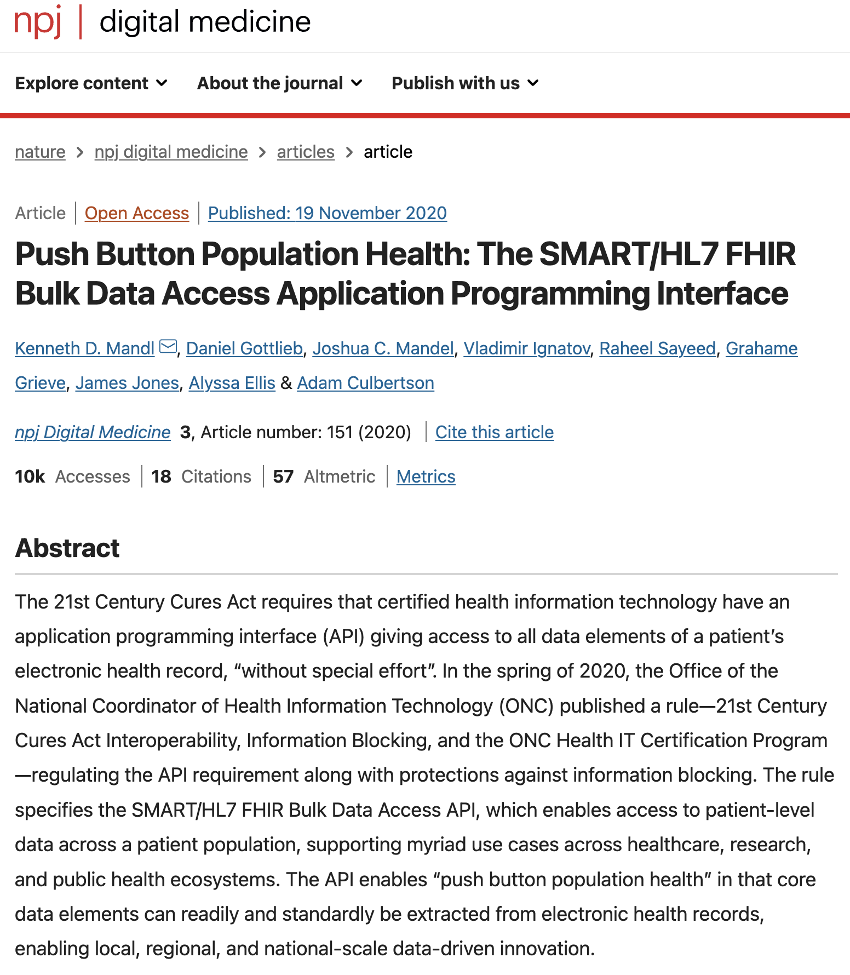


Discussion: Use new privacy-enhancing technique to catalyze secondary re-use, for example, secure multiparty computation
Catalyze secondary re-use by enabling analytics in the blind with MPC
Use new analytics-on-FHIR standard to connect MPC
Partnership with Roseman Labs and local university
SHR
MPC

Slide 18
APPENDIX: CCM KENYA

Slide 19
Example: CCM project Kenya
Point for discussion CCM programme (details in next slides)
Detail main process and data flow between CCM app and Meds
Evaluate whether we want to continu with homebuild app, or restart with FHIR native framework
Define data that will be pushed to shared health record to start building International Patient Summary (IPS) record
COMMON
SERVICES
CR - Client Registry
FR - Facility Registry
HWR - Health Worker Registry
TS - Terminology Services
PC - Product Catalogue
BUSINESS
SERVICES
FIS - Finance & Insurance Service
HMIS - Health Mgt. Info. System
LMIS - Logistics Mgt. Info. Service
SHR - Shared Health Record
DS - Data Services (?!)
ANALYTICS & INTELLIGENCE SERVICES
Secondary re-sue of data
Shared health record
INTEROPERABILITY LAYER (IOL)
AC - Admin Console
ATNA - Audit Trail & Node Authentication
ILS - Interlinking and Routing Services, also known as Channels in the reference implementation
MEDIATORS - Pass-through, Adapter or Orchestration mediators
POINT OF SERVICE (POS) SYSTEMS
Different types of PoS systems are allowed, including EMR/EHRs (Electronic Health / Medical Record systems), mobile apps for patient or community workers and information systems for hospitals, pharmacies and laboratories.
Key defining characteristics are the workflows that are supported by the system (see examples).
CCM App
Meds
Member registration
Contribution

Slide 20
1. Detail main process and data flow between CCM app and Meds
FHIR has different resources to support medication-related workflow including billing. Note, however, these resources are still in draft stage so we can be pragmatic here
MedicationDispense resource
ChargeItem resource
We need a Product Catalogue Terminology Service to uniquely identify which medication has been dispensed

Slide 21
2. Evaluate whether we want to continu with homebuild app, or restart with FHIR native framework
Option: OpenSRP
Kotlin Android app framework built on Google FHIR SDK
To investigate: does it have USSD functionality?
Option: Community Health Toolkit
Seems more tailored/relevant for CCM app
Has USSD functionality
Downside: not FHIR native, needs translator (link)

Slide 22
3. Define data that will be pushed to shared health record to start building International Patient Summary (IPS) record
Details: FHIR IPS
Suggestion: push Medication Summary and Problem List to shared health record

Slide 23
Appendix

Slide 24
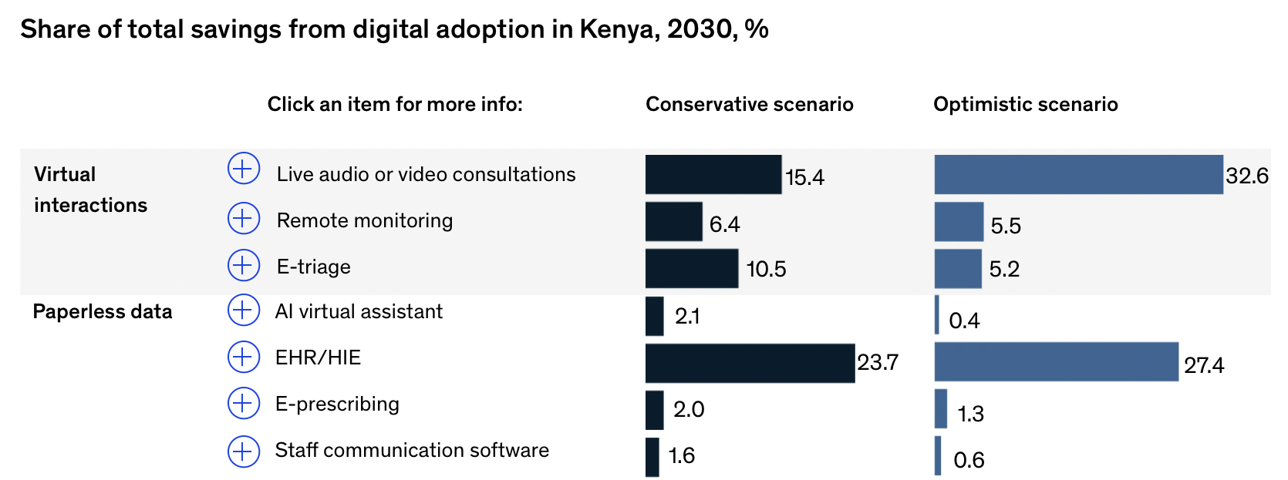
McKinsey sees virtual interactions and paperless data as the main drivers of efficiency gains in the coming 7 years
62-73% of all efficiency gains are in these 2 categories
“How digital tools could boost efficiency in African health systems”; www.McKinsey.com; 2023

Slide 25
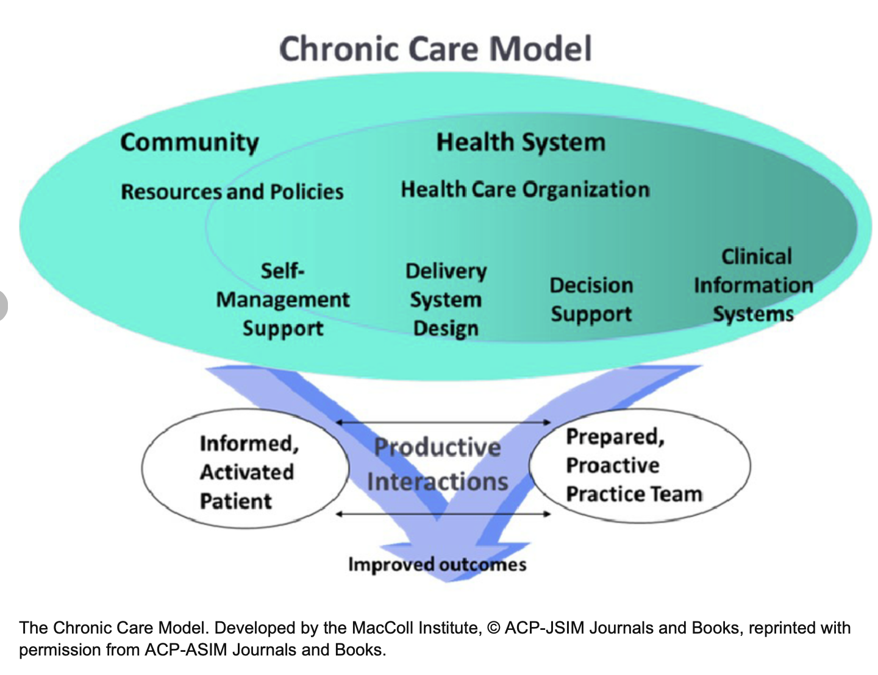
Blended models| Effective tools require collaboration and data exchange
Example:
Chronic care
Increasingly include wider services, e.g. medicine platforms, fintech solutions

Slide 26
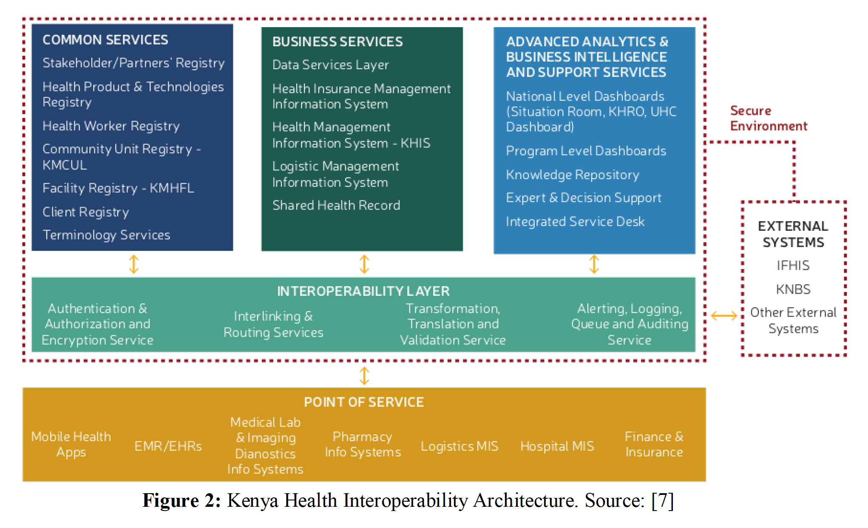
Kenya Health Interoperability Architecture What would it take to demonstrate or kick start at a smaller scale?

